Slide 1
ASSIGNMENT 6 PROJECT TITLE: HOME SECURITY SYSTEM
SUBMITTED BY: STEPHY BABY C0753812
Group #4

Slide 2
IMPLEMENTATION ON CIRCUIT DESIGN
Introduction.
Interfacing LPC2148 with ST7920 GLCD.
Interfacing LPC2148 with Buzzer.
Interfacing LPC2148 with ESP32.
Interfacing NRF24L01 with PIR and LPC2148.
Schematic diagram.
References.

Slide 3
INTRODUCTION
EasyEDA is the software used for schematic design.
It provides thousands of open source software to make schematic design and stimulation easier.
User can access and contribute lots of free libraries.
User can create own symbols either by copying existing symbols or by drawing them from scratch.
It provides Drag and Drop facility.

Slide 4
CREATING NEW PROJECT IN EASYEDA
Download EasyEDA software.
Create new project.
Adding schematic diagram page.
Searching and adding components from part library.
Draw connection between the terminal.

Slide 5
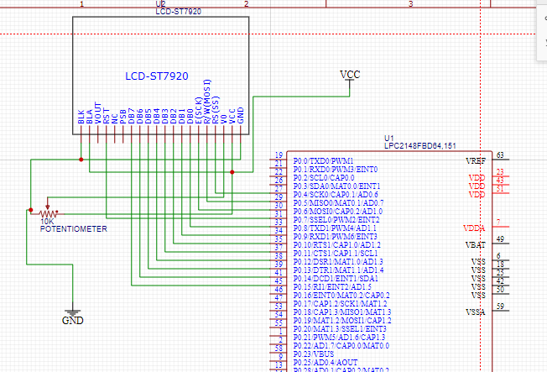
INTERFACING LPC2148 WITH ST7920 GLCD.
VCC and GND pins are connected from power supply
10k potentiometer is used to adjust the contrast of LCD.
R/W pins and ENABLE pins are connected to P0.5 and P0.6 pins of LPC.
Data pins from D0-D7 are connected to P0.8-P0.15 of LPC respectively.
Backlight anode pin is connected to VCC and cathode is connected to GND.

Slide 6
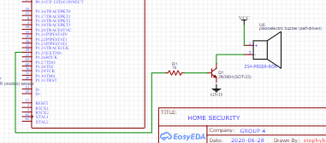
INTERFACING LPC2148 WITH BUZZER.
VCC of buzzer is directly connected to VCC of power supply.
GND of buzzer is controlled by NPN transistor to enable the buzzer control.
P1.25 of LPC is used to control the buzzer by applying voltage to the base of transistor.

Slide 7
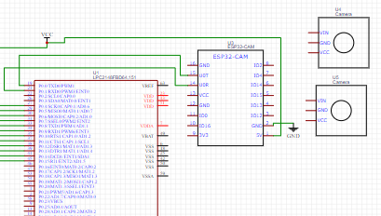
INTERFACING LPC2148 WITH ESP32.
ESP32 module powered from VCC and GND from power supply.
Enabling commands are transmitted through TX (P0.0) and RX(P0.1) of LPC.
When the ESP 32 is activated Wi-Fi-cameras will be automatically on.

Slide 8
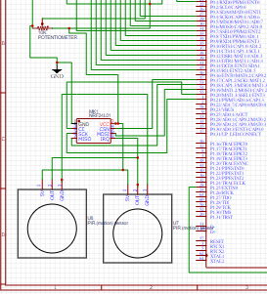
INTERFACING NRF24L01 WITH PIR AND LPC2148.
VCC and GND are connected to power supply.
OUT from PIR sensor is feed to IRQ pin (interrupt pin) of NFR24L01 module.
SPI communication with LPC is established by MISO and MOSI pin of transceiver connected to P0.18 and P0.19 respectively.

Slide 9
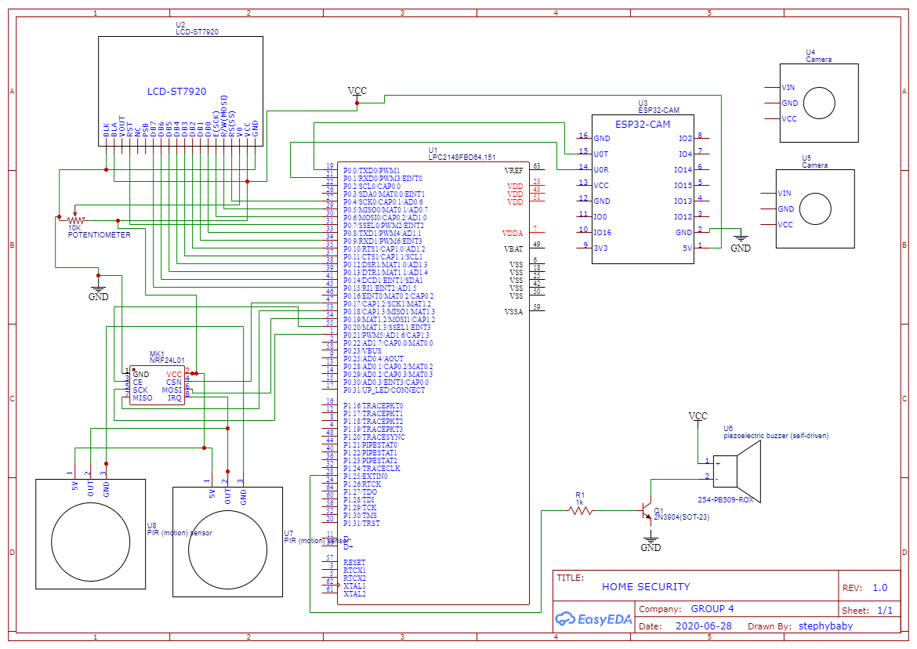
SCHEMATIC DIAGRAM

Slide 10
REFERENCES
EasyEDA tutorial, an easier and powerful online designing tool. Retrieved from : https://docs.easyeda.com/en/Introduction/Schematic-Capture/index.html
Interfacing LCD with LPC 2148 ARM. Pantech solutions.net: Retrieved from: https://armprocessorforu.files.wordpress.com/2014/12/7-glcd_interfacing_with_arm7_primer.pdf
Tutorial 1: Getting a Simple Link Going with the nRF24L01 and the nRF24L01 C library. Brennen Ball(2007) ;Retrieved from: http://www.cs.mun.ca/~paul/cs4723/material/nordic/nRF24L01_Tutorial_1.pdf
PIR sensors interfacing with LPC2148. Embetronix. Retrieved from: https://embetronicx.com/tutorials/microcontrollers/lpc2148/pir-sensor-interfacing-lpc2148/

